Slide 1
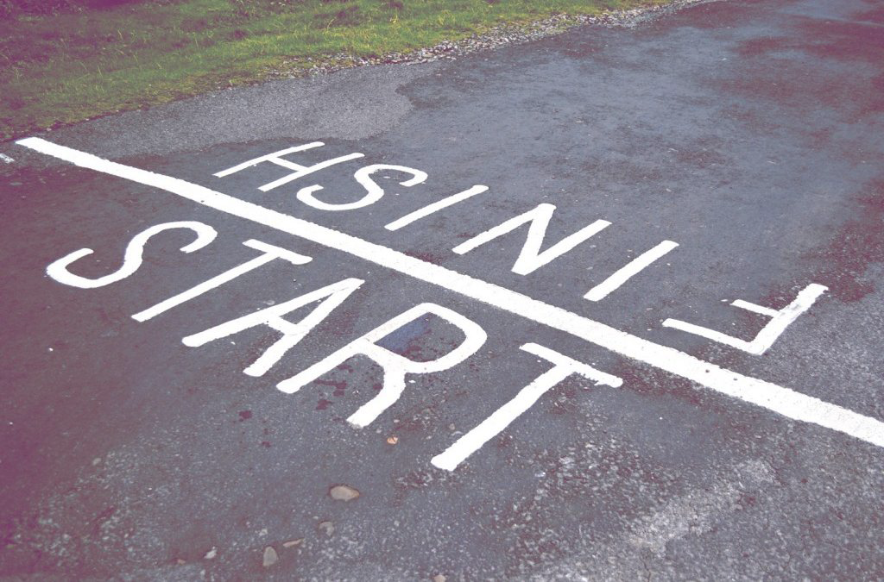
Stories of Loss: Fragility in the Archive
The Endings Project
bit.ly/csdh2019
J. Matthew Huculak & Claire Carlin
hcmc.uvic.ca/endings
projectendings.github.io

Slide 2
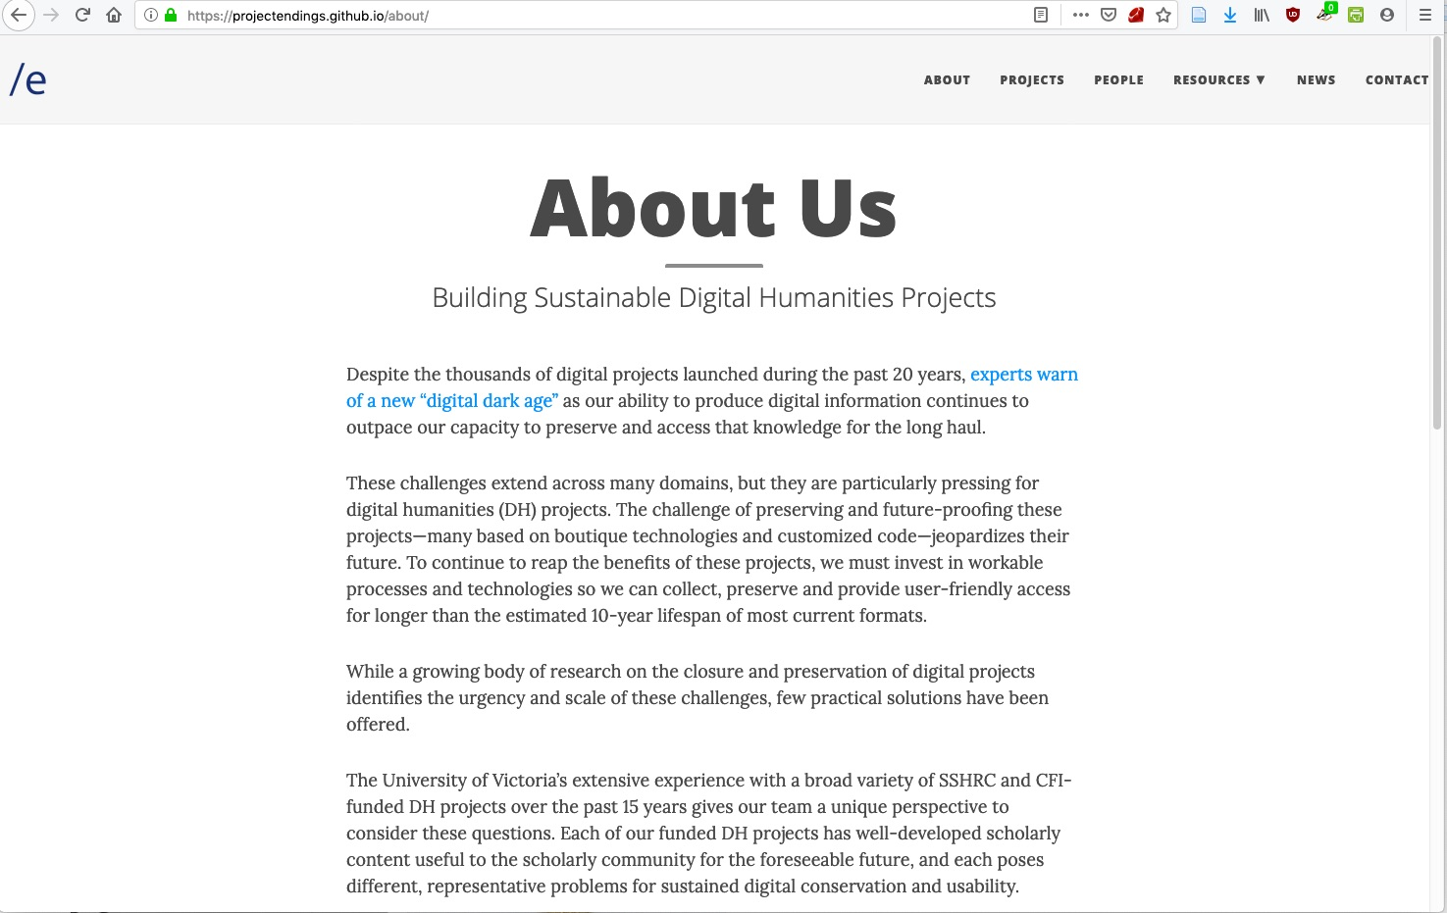
“Endings: Concluding, Archiving, and Preserving Digital Projects for Long-Term Usability”
SSHRC Insight Grant - $270,000 - 4 Years

Slide 3
https://hcmc.uvic.ca/endings/
Humanities Faculty
Claire Carlin, Le Mariage sous l’Ancien Régime
Ewa Czaykowska-Higgins, The Nxa’amxcin Database and Dictionary
Janelle Jenstad, The Map of Early Modern London
Librarians
Corey Davis, Systems Librarian
John Durno, Head of Library Systems
Lisa Goddard, Associate University Librarian for Digital Scholarship and Strategy
J. Matthew Huculak, Digital Scholarship Librarian
Humanities Computing Media Centre (HCMC)
Martin Holmes, Programmer Consultant
Stewart Arneil, Programmer Consultant
Greg Newton, Programmer Consultant
Research Assistants
Emily Comeau, Sarah Kell, Daniel Martin, Tye Landels-Gruenewald, Jennifer Polack, Joseph Takeda

Slide 4
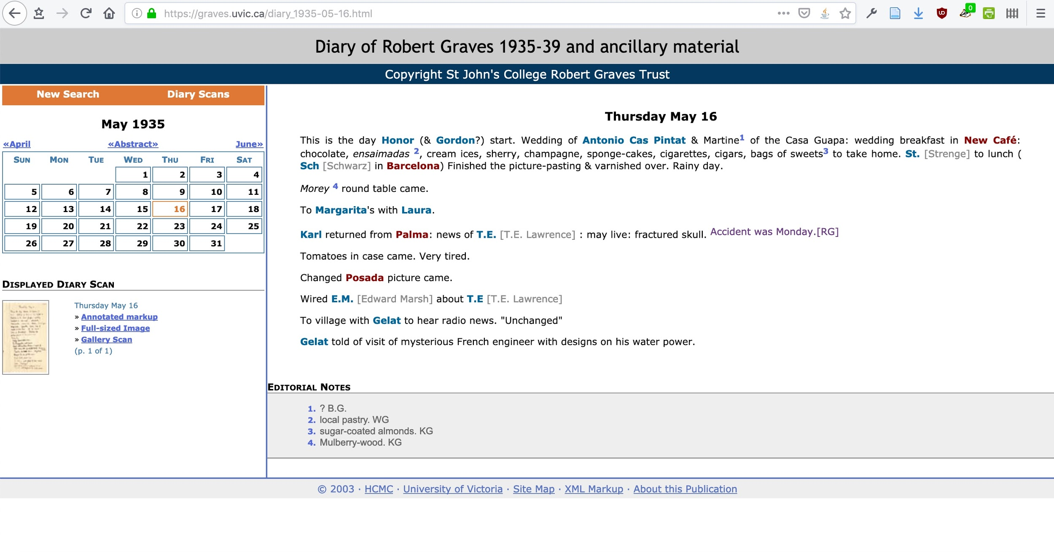
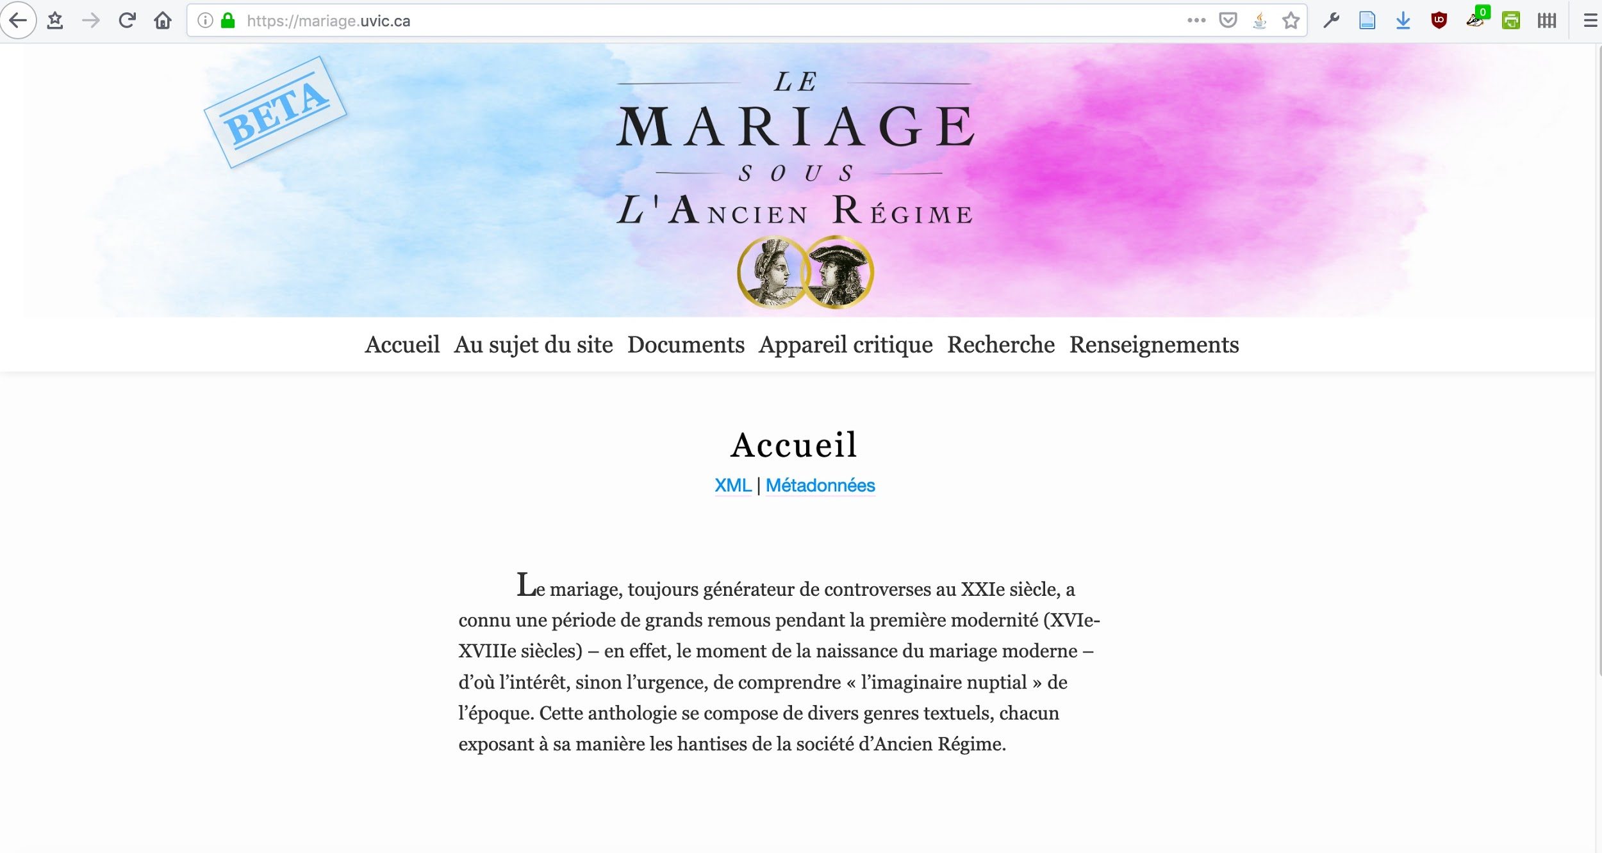
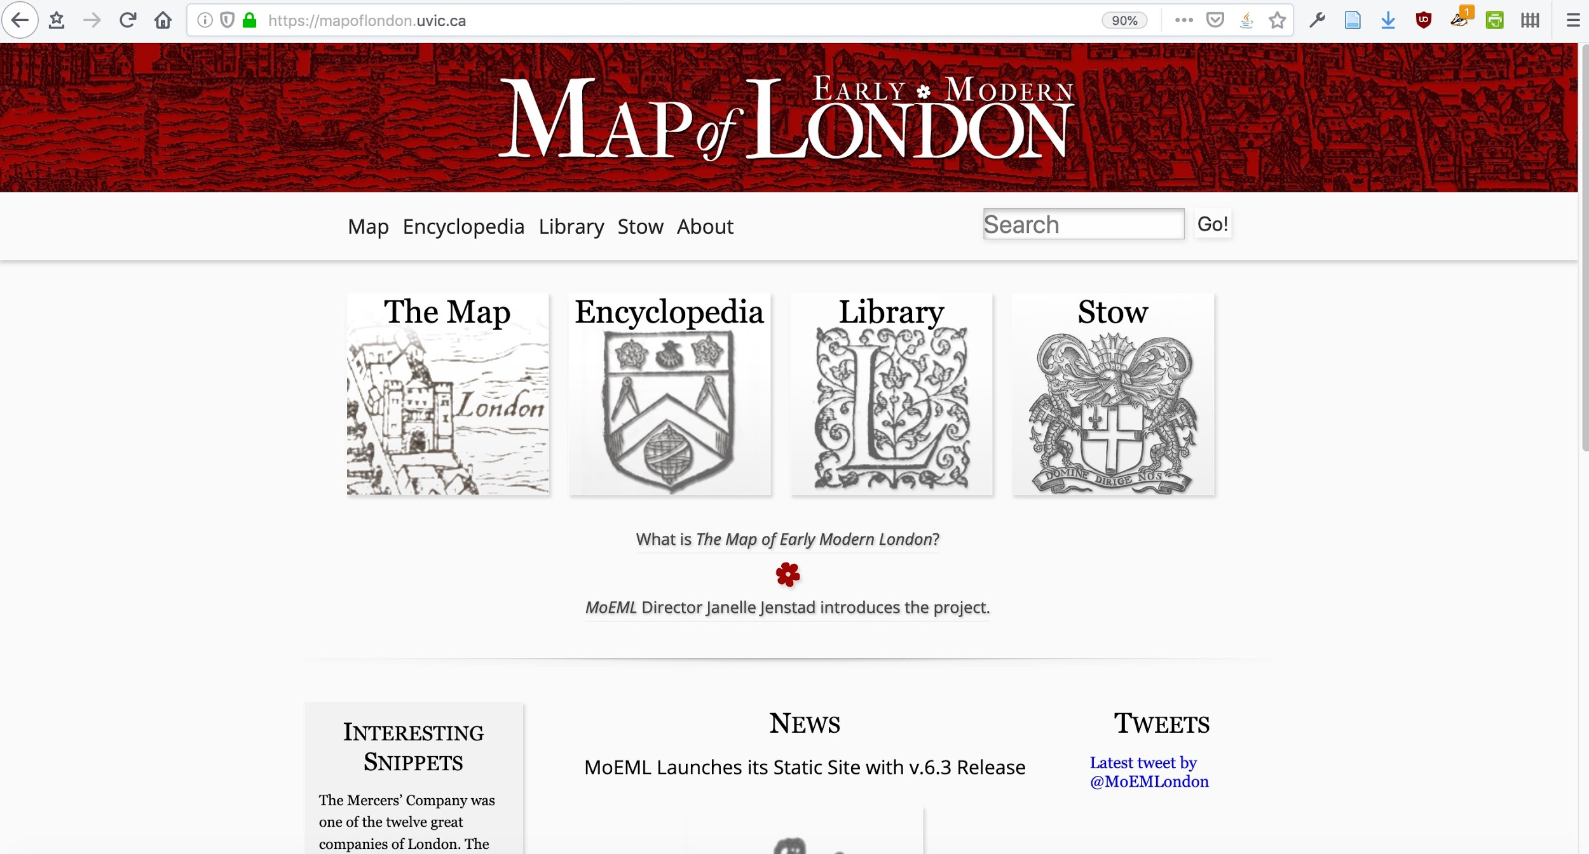
Original projects

Slide 5
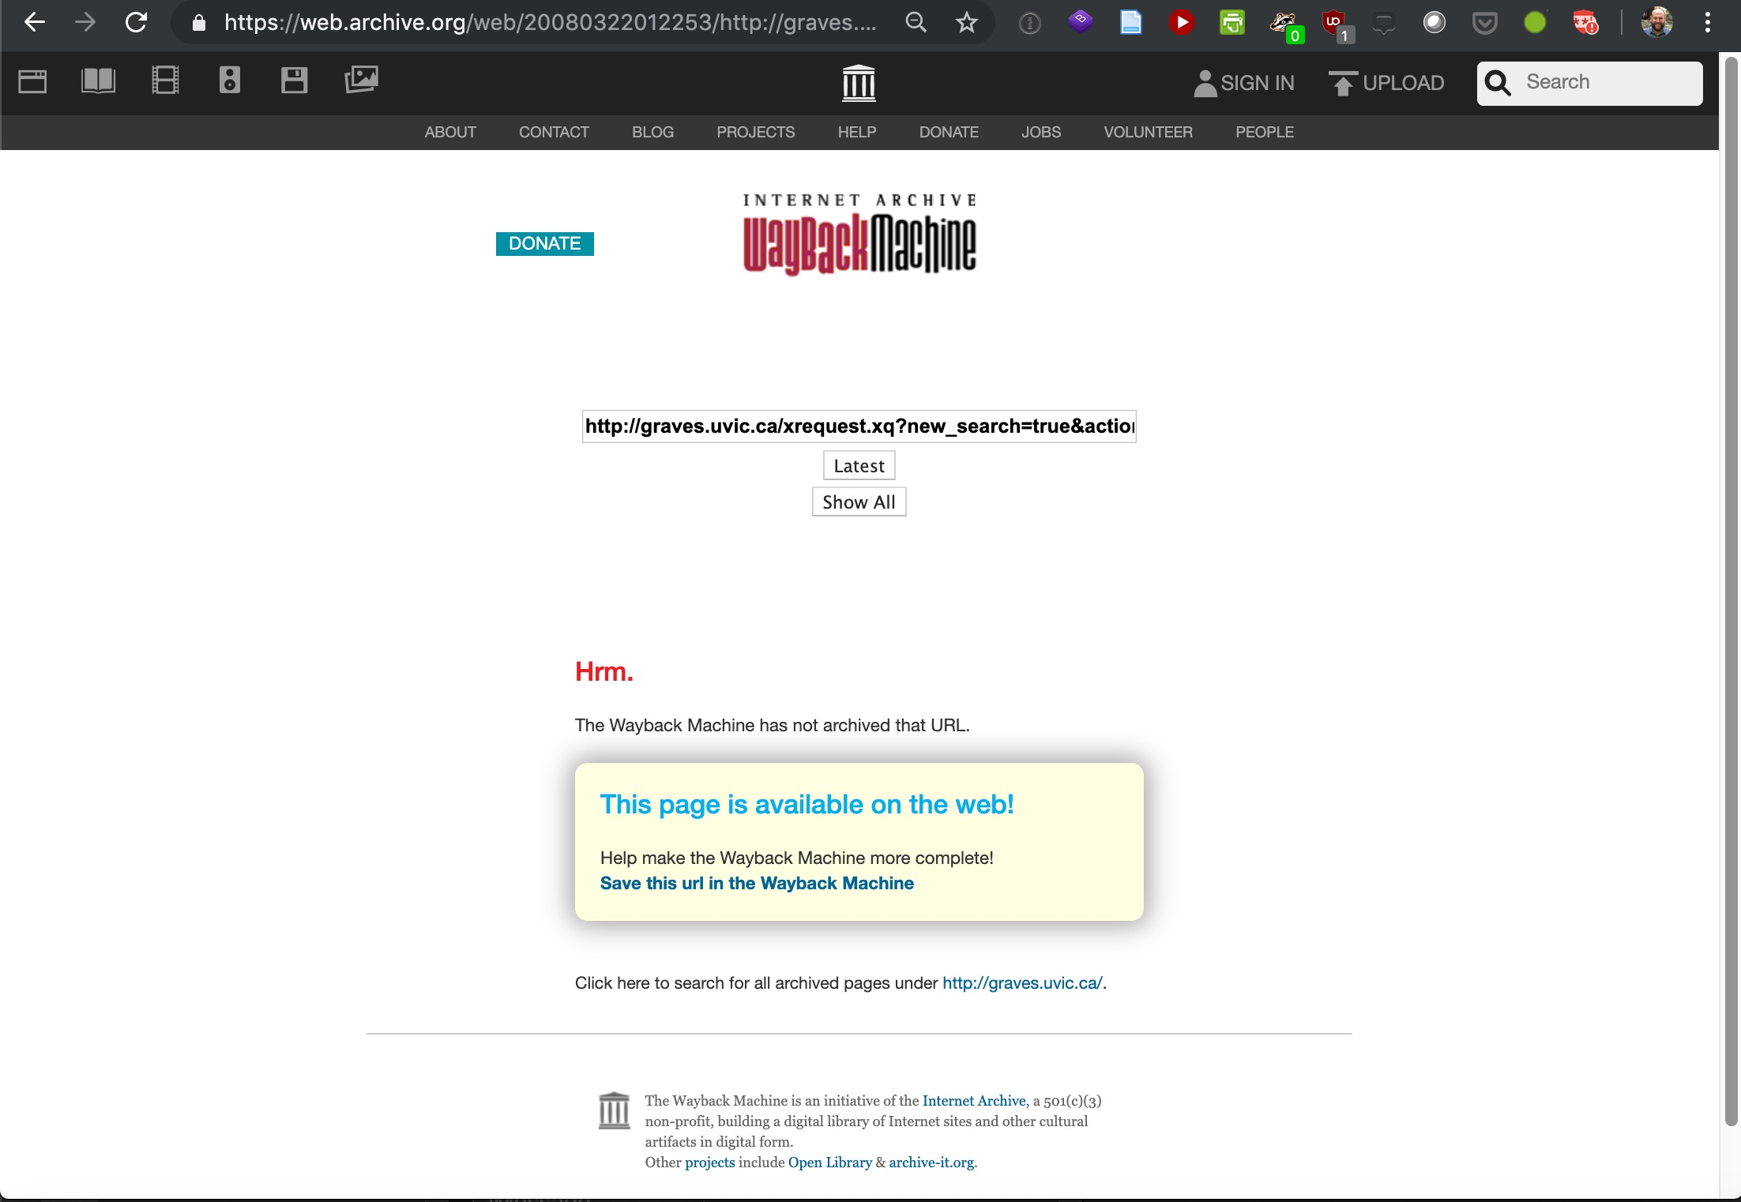
Problem: web archiving

Slide 6
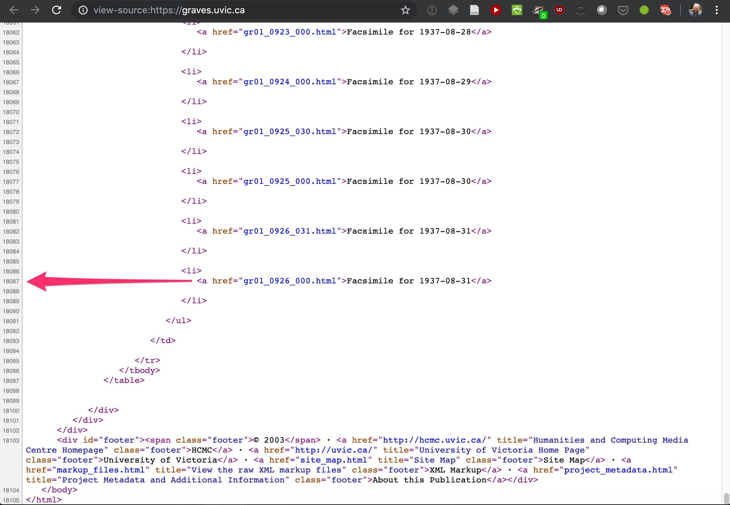
Solution: Hard linking

Slide 7
Long-term accessibility
In Canada alone, SSHRC has invested $15.8 million on 138 projects through its (former) ITST program.
How DO digital humanities projects conclude?
How SHOULD digital humanities projects conclude?
Short answer: They don’t.

Slide 8
Surveys & interviews
Survey of DH project leads: 127 responses
In-depth interviews: 25 (currently being TEI encoded)

Slide 9
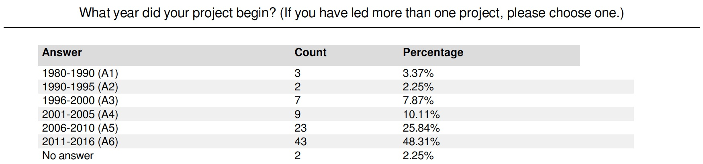
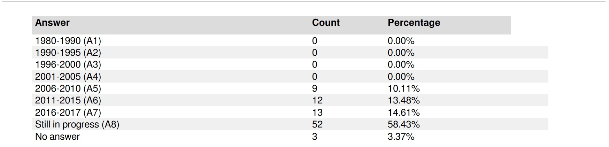
Survey Results

Slide 10
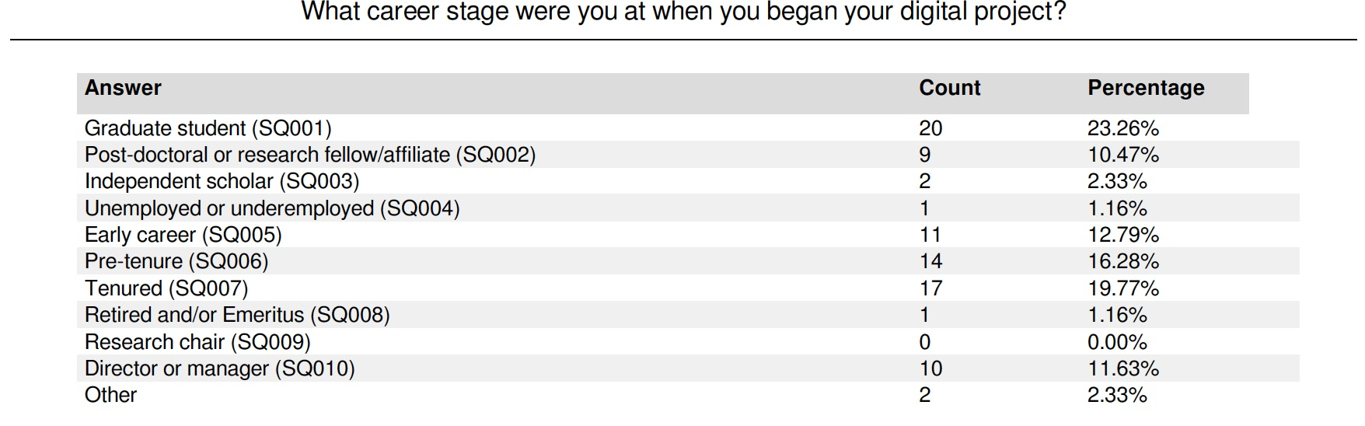
Career Stage

Slide 11
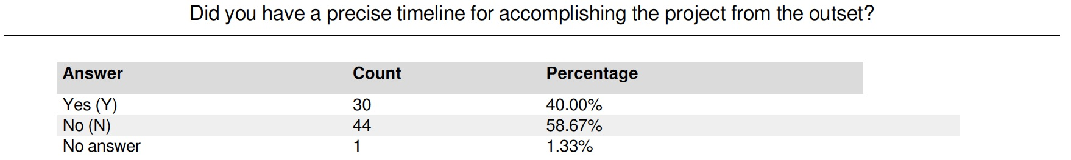
Did you have a timeline?

Slide 12
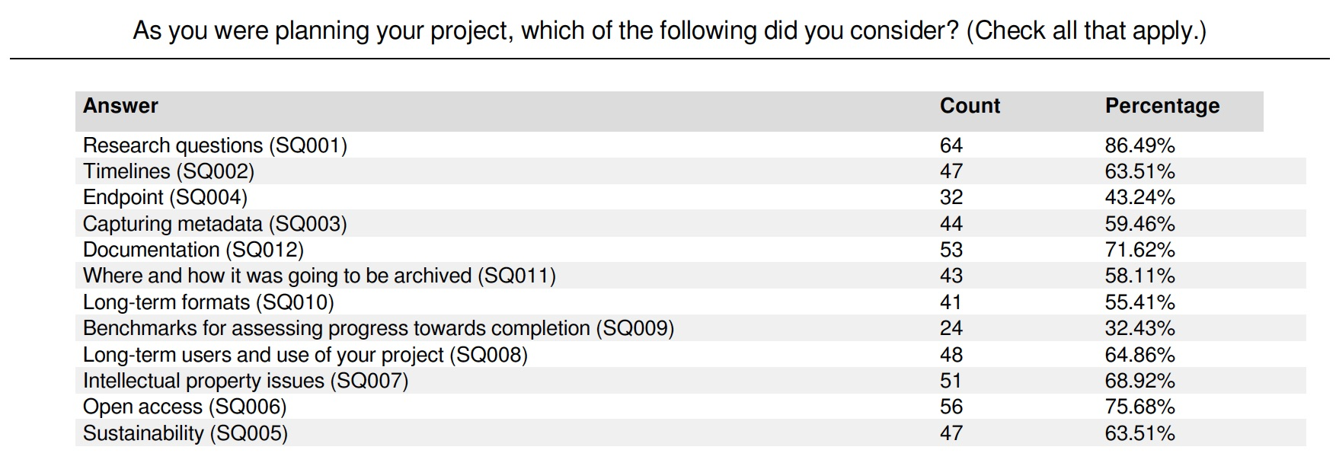
What questions were you thinking about?

Slide 13
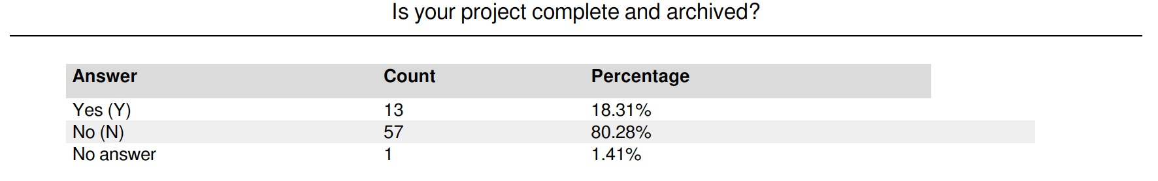
Is the project complete & archived?

Slide 14
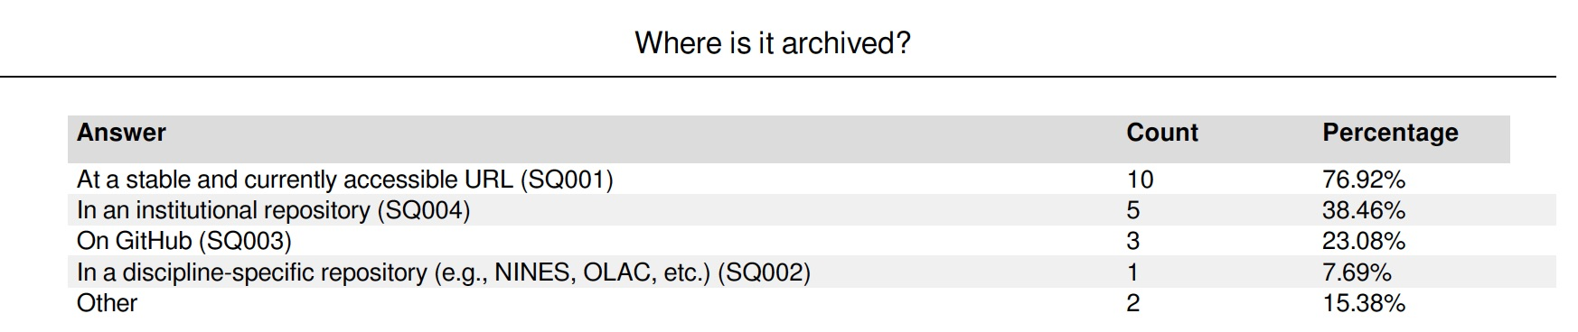
If complete, where is it archived?

Slide 15
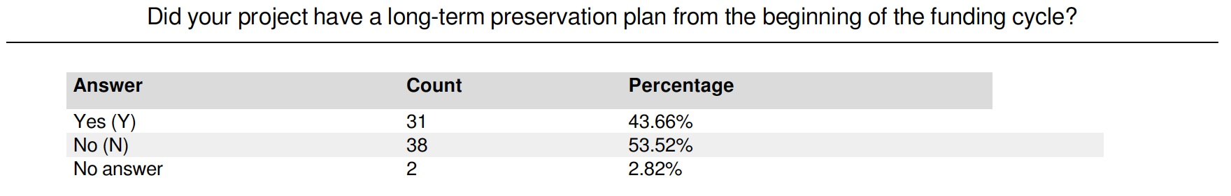
Preservation Plan

Slide 16
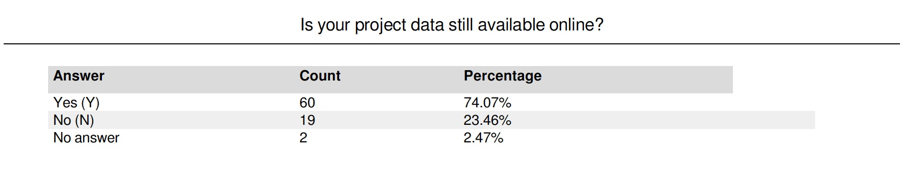
Availability of Data

Slide 17
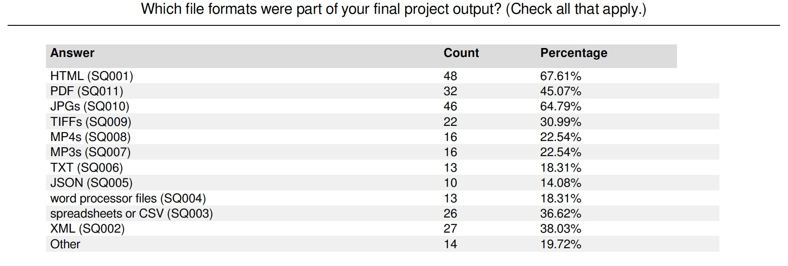
File Formats

Slide 18
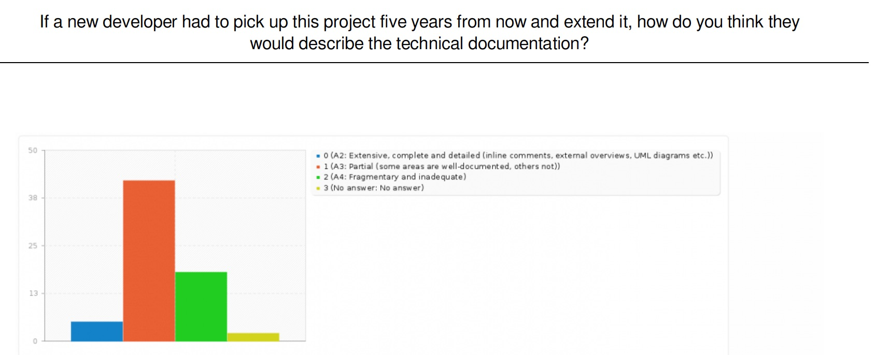
Documentation

Slide 19
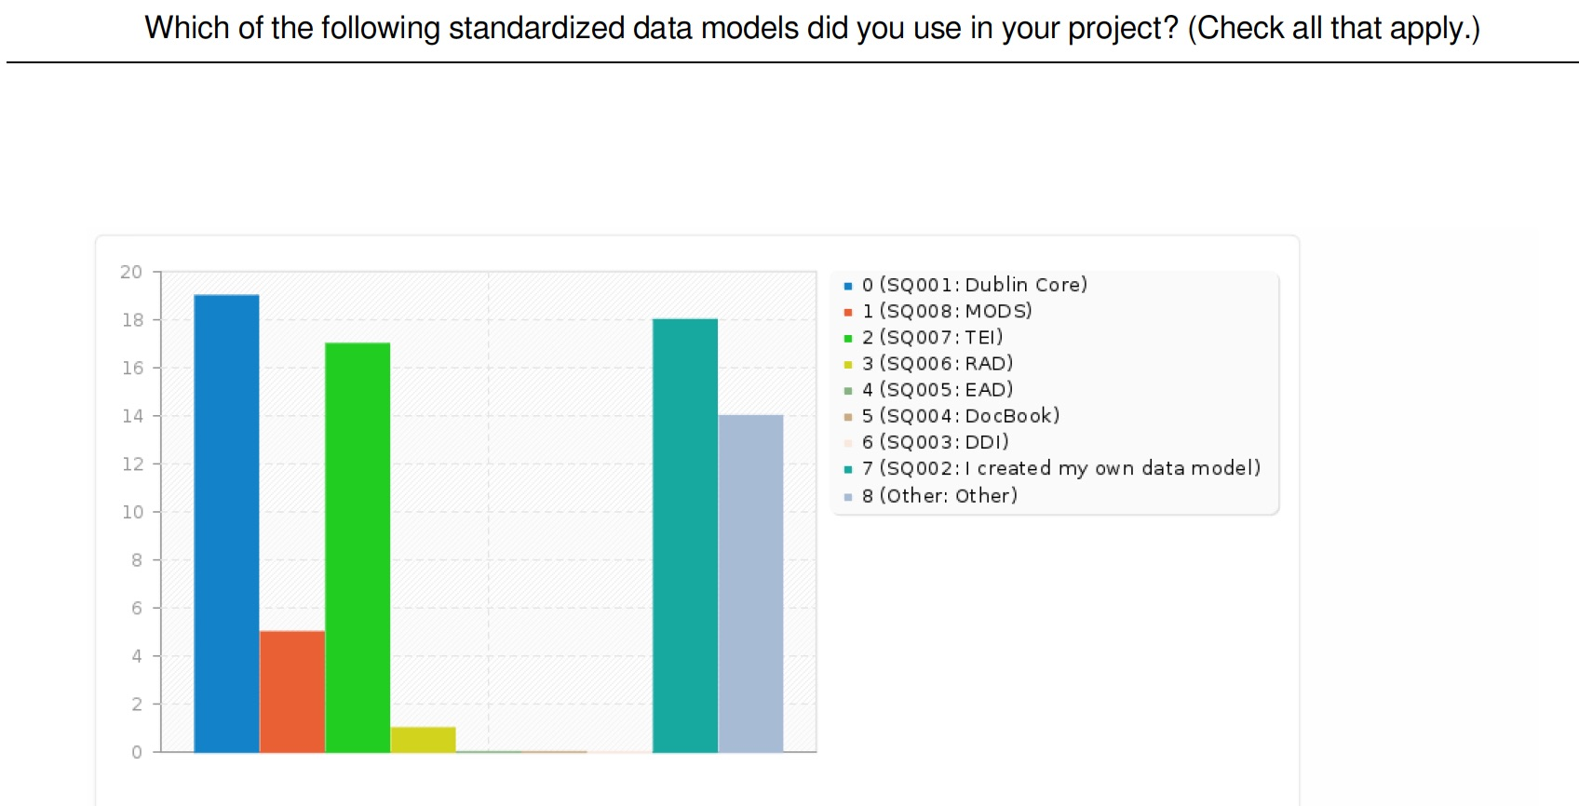
Data models

Slide 20
Follow-up interviews
25, 1-hour interviews conducted with those who self-identified as being willing to meet via Skype

Slide 21
Categories
Data
Documentation
Funding
Hosting
Institutional
Project Management
Project Outputs
Rights
Scholarly/academic issues
Storage, backup, and preservation
Team

Slide 22
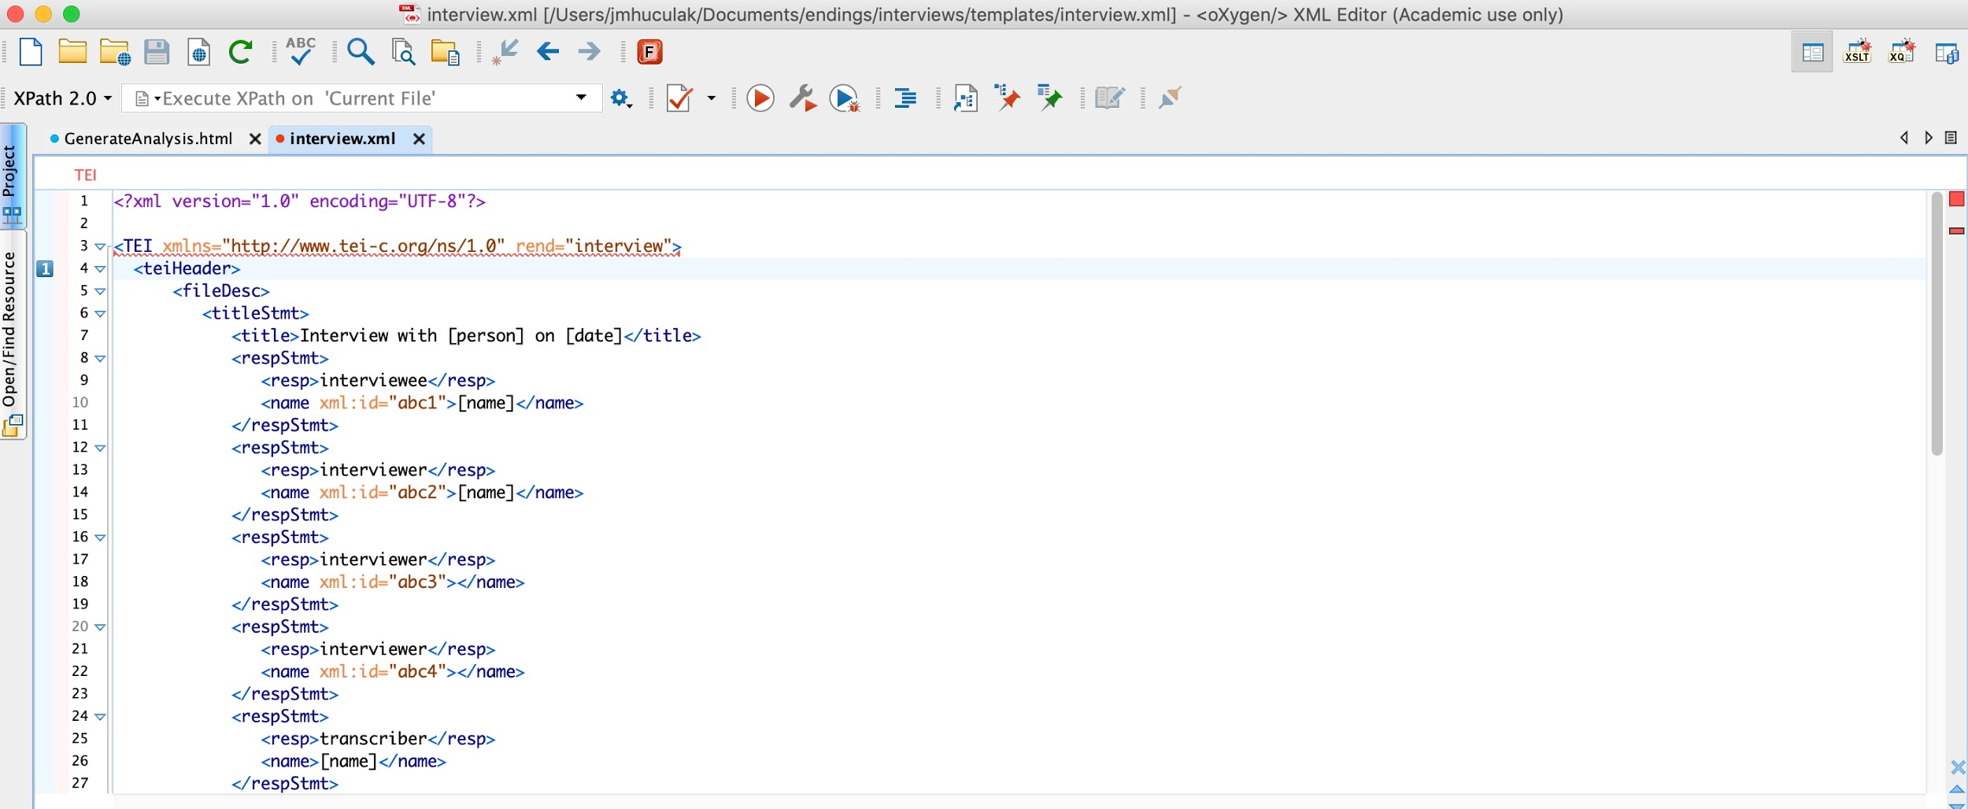
Transcription & TEI

Slide 23
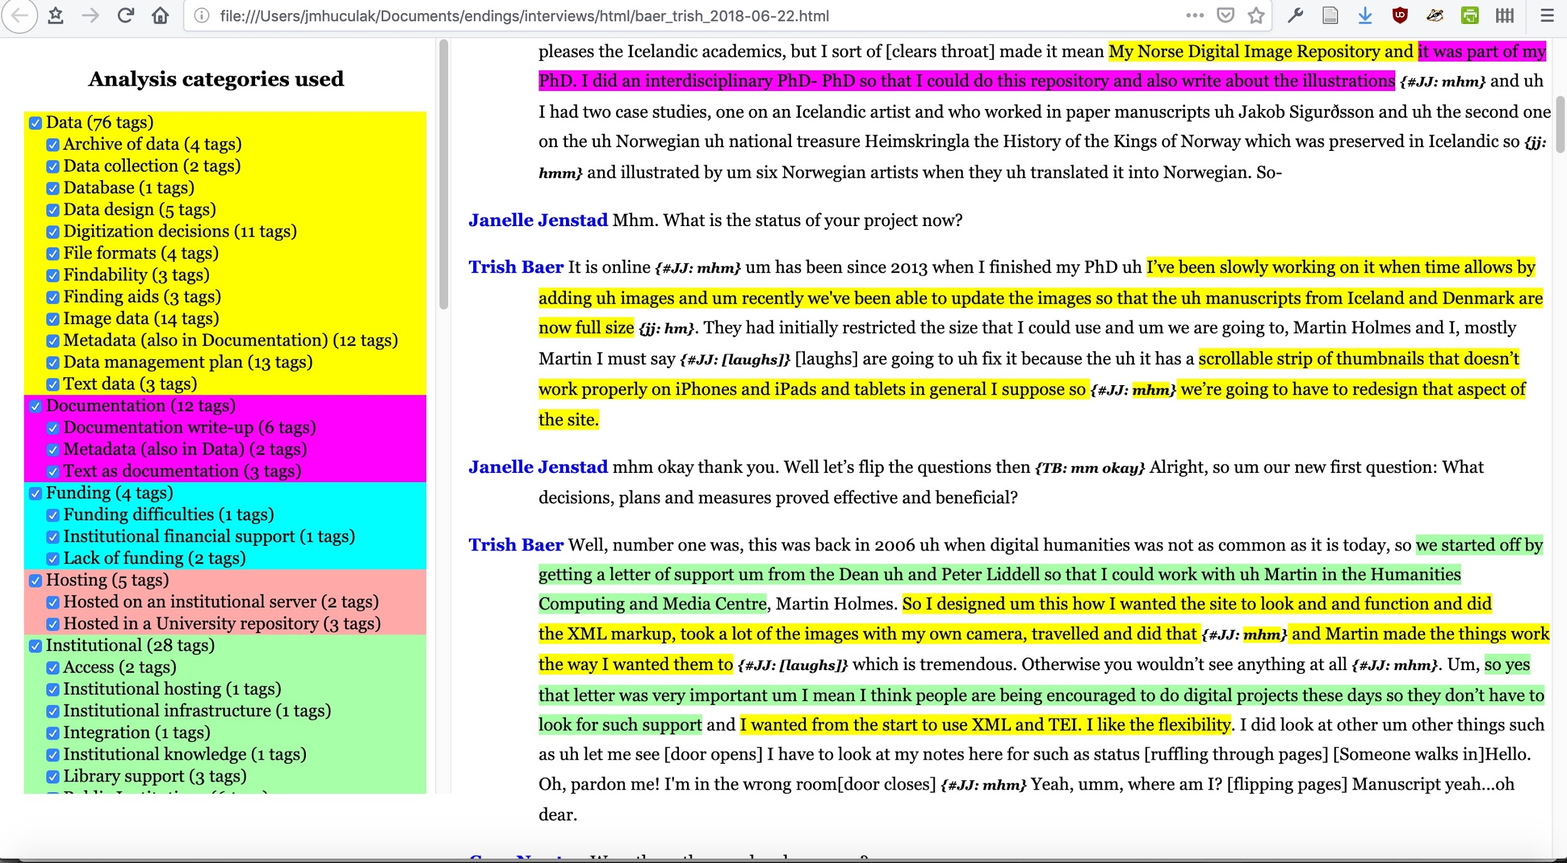
Transcription & TEI

Slide 24
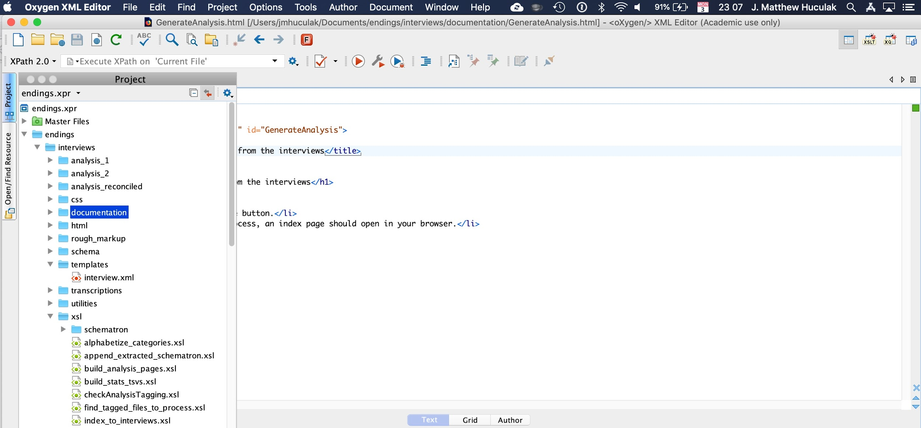
Analysis reconciliation

Slide 25
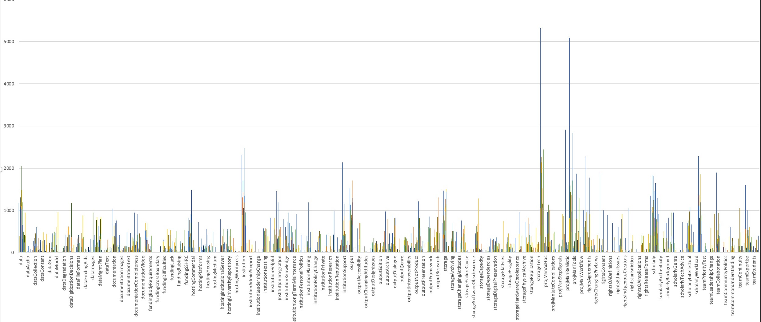
Preliminary Instance Counts

Slide 26
Preliminary results-Team

Slide 27
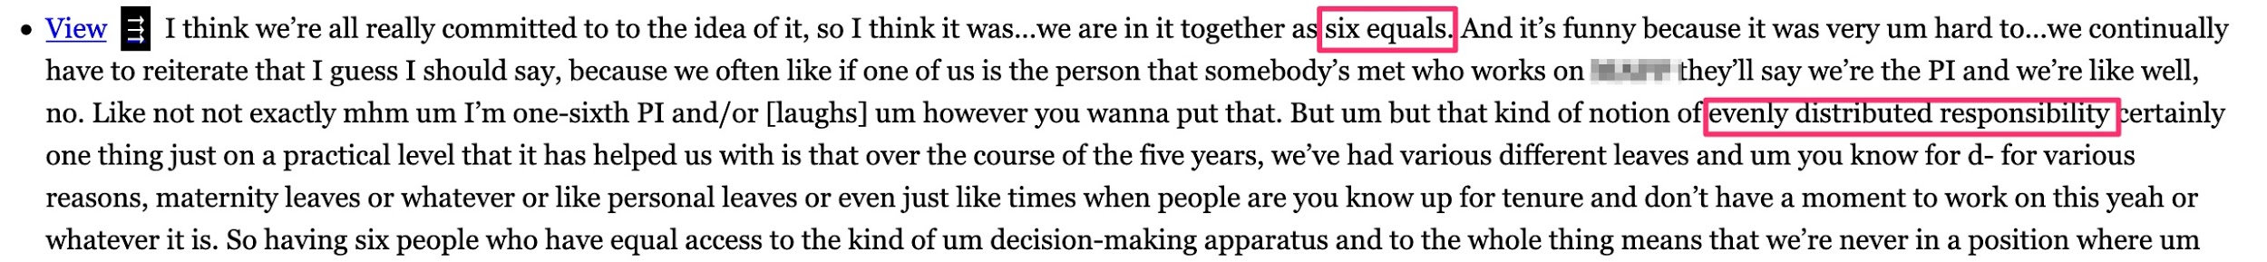
Preliminary results- Team

Slide 28
Preliminary results- Storage

Slide 29
Preliminary results- Storage

Slide 30
Preliminary results- Storage

Slide 31
Preliminary results- Storage

Slide 32
Personal Observations (not vetted by team)
People want to follow best practices but are not trained/experts in all the moving parts of making a project last.
People have good-faith intentions that override complexities of human relationships.
Loss of data usually follows a loss in a personal relationship due to death/change of professional status, etc.
Library and archive support uneven (depending on status of PI, resources of institution, etc.).
Reluctance to separate idea of “website” from “data.”

Slide 33
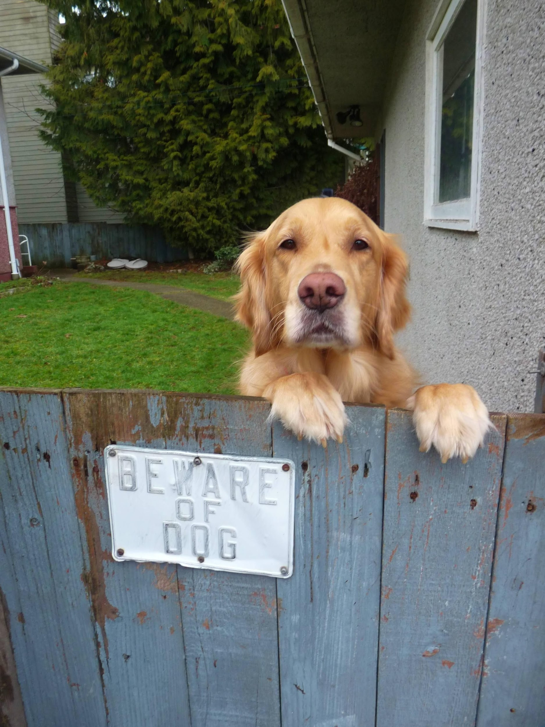
Endings principles
How to fail gracefully

Slide 34
Endings principles
Data
Products
Processing
Documentation
Release management
https://projectendings.github.io/principles/

Slide 35
Data (is not your website)
Data is the expression of the source information, knowledge, and expertise of our researchers. The following principles apply to data:
Data is stored only in formats which conform to open standards and which are amenable to processing (TEI XML, GML, ODF, TXT).
Data is subject to version control (Subversion, Git).
Data is continually subject to validation and diagnostic analysis.
https://projectendings.github.io/principles/

Slide 36
Products
Products are the project output intended for end-users, typically in the form of websites or print documents.
No dependence on server-side software: build a static website with no databases, no PHP, no Python.
No boutique or fashionable technologies: use only standards with support across all platforms, whose long-term viability is assured. Our choices are HTML5, JavaScript and CSS.
No query strings: every entity in the site has a unique page with a simple URL.
Graceful failure: every page should still basically work even in the absence of JavaScript or CSS support.
https://projectendings.github.io/principles/

Slide 37
Documentation
Data models, including field names, descriptions, and controlled values, should be clearly documented in a static document that is maintained with the data, and should also form part of the products.
All rights and intellectual property issues should be clearly documented. Where possible the Data and Products should be released under open licenses (Creative Commons, GNU, BSD, MPL).
https://projectendings.github.io/principles/

Slide 38
Release Management
Release management handles the public release of products. Without good release management, a project can never end gracefully; it can only falter and die.
Releases should be periodical and carefully planned. The “rolling release” model should be avoided.
A release should only be made when the entire product set is coherent, consistent and complete (passing all validation and diagnostic tests).
Like editions of print works, each release of a web resource should be clearly identified on every page by its build date and some kind of version number.
Web resources should include detailed instructions for citation, so that end-users can unambiguously cite a specific page from a specific edition.
https://projectendings.github.io/principles/

Slide 39
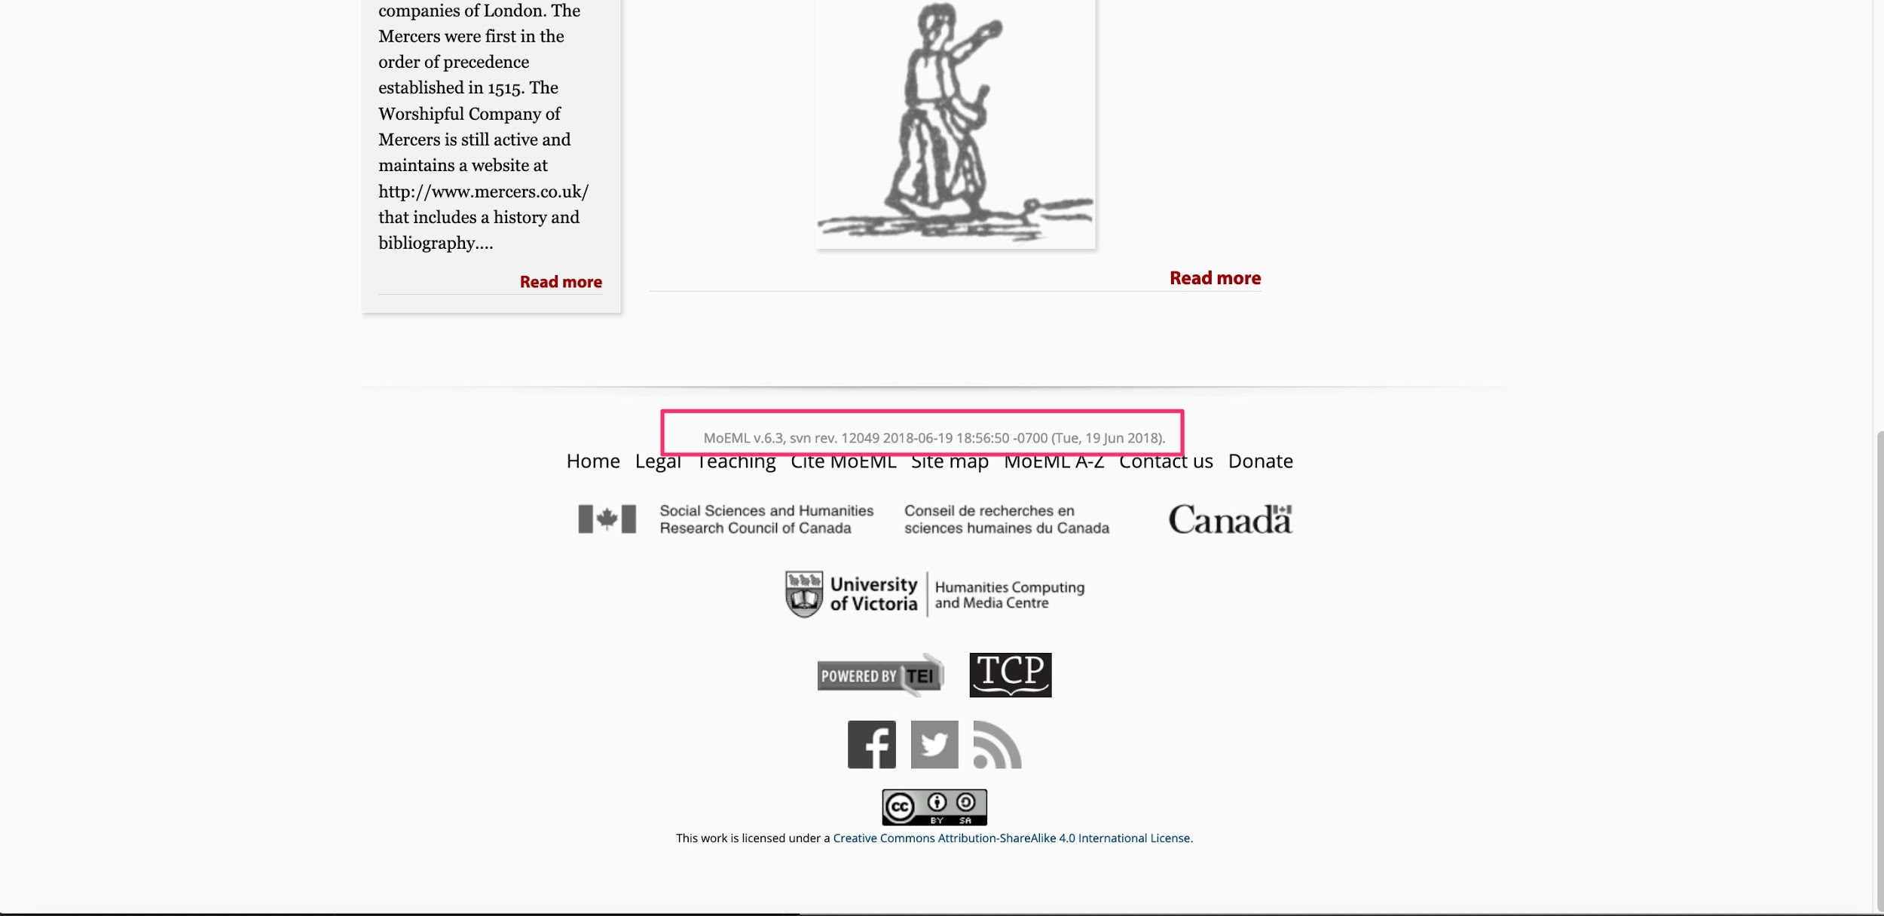

Slide 40

Project Outputs
Four digital editions finished and archived.
Toolkit for creating static version of websites.
Diagnostic tools
help track tasks to completion
produce documentation
Set of principles/guidelines for ending and archiving projects.
Training materials for DH researchers.
Indicator of being “endings compliant”

Slide 41
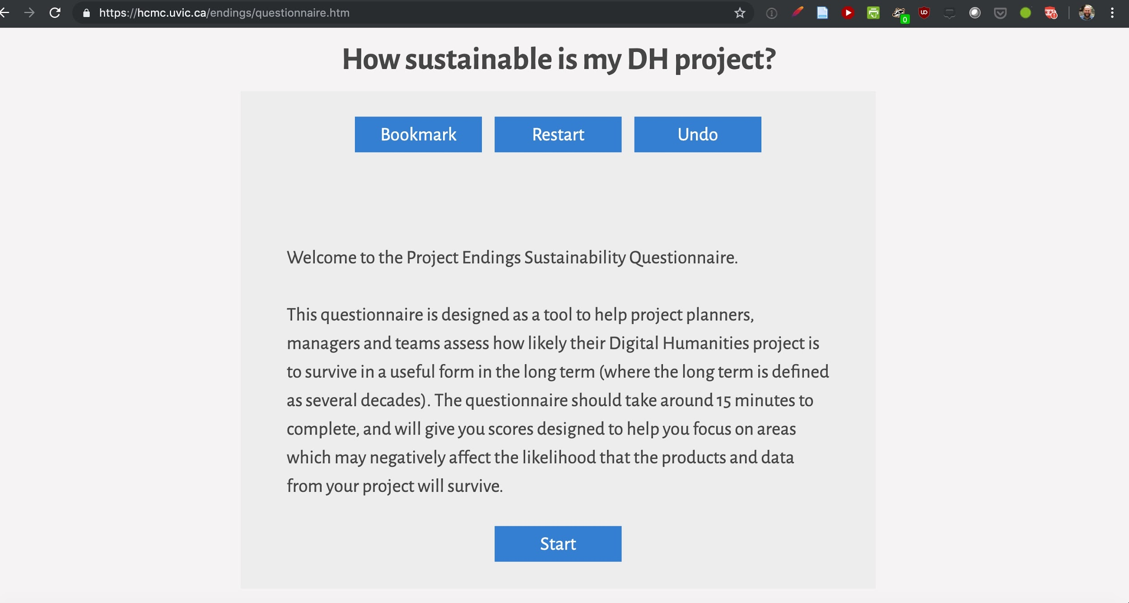

Slide 42
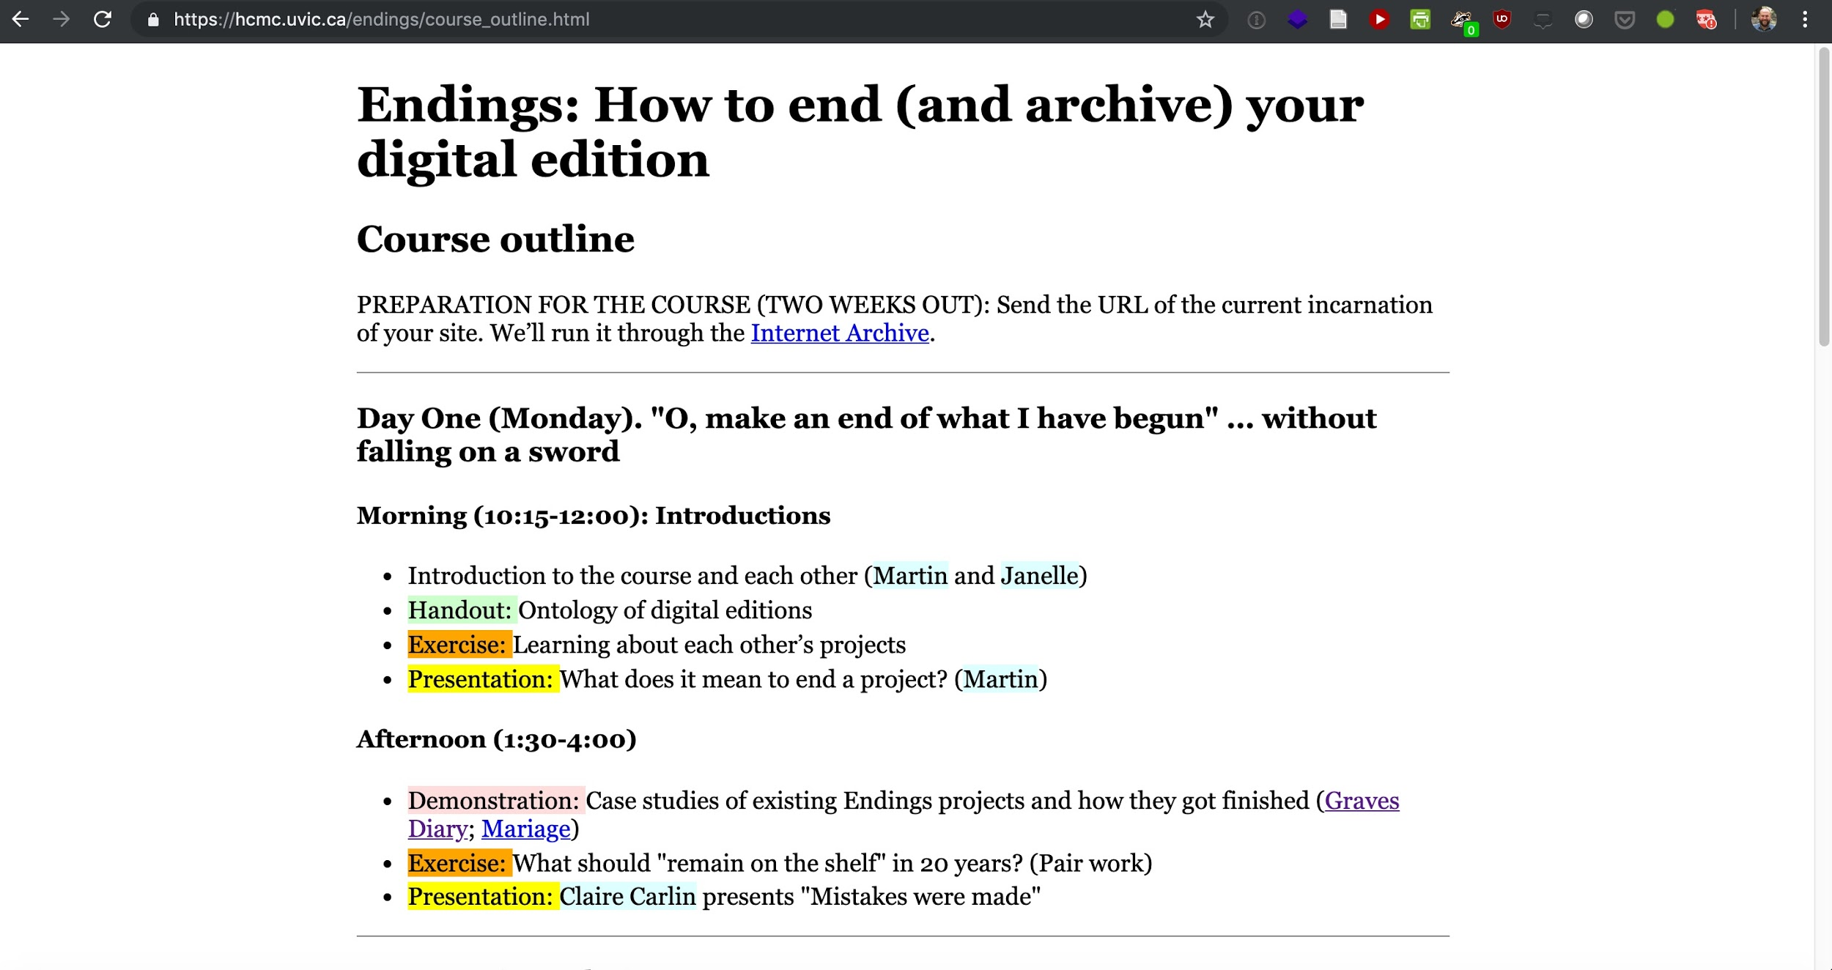

Slide 43
Thank you
Questions?
Look forward to our whitepaper in the coming year!

